Slide 1



Mini-Project Problem A
Group 12
YIKE ZHANG, KEHAN LI,
TIANAO HU, CALVIN CAMERON- COLE

Slide 2
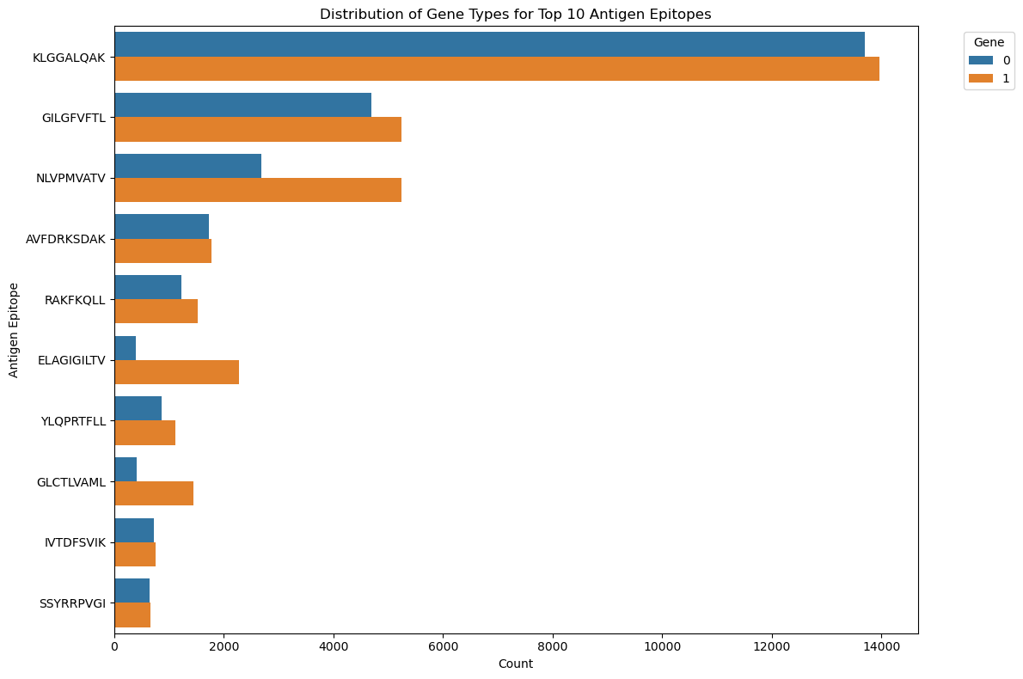


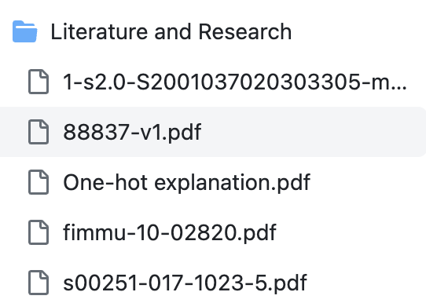

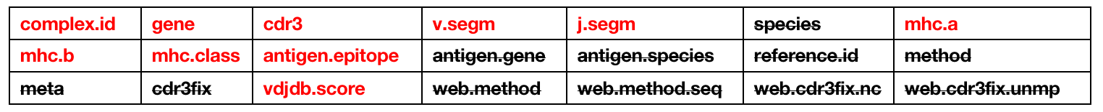
Visualisation
DATA SOURCE
Research

